Slide 1
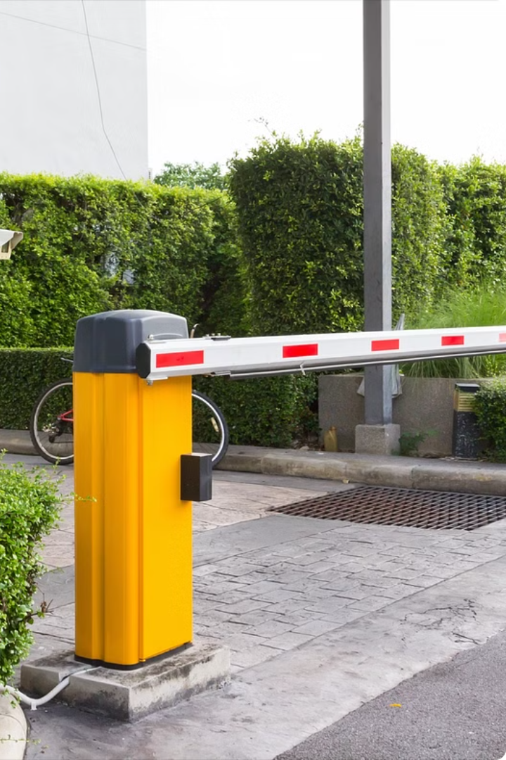

Introduction to Automatic Parking Gate System
Explore the power of Arduino Uno-based automatic parking gate systems, a cutting-edge technology that revolutionizes parking management. Discover how these intelligent systems streamline access control, enhance security, and provide a seamless parking experience.
RM
By Abhi tipale

Slide 2
Components of the System
Microcontroller
Ultrasonic Sensor
The Arduino Uno, a popular open-source microcontroller, serves as the brain of the automatic parking gate system, controlling the various sensors and actuators.
This sensor detects the presence of a vehicle approaching the gate, triggering the opening and closing mechanism.
Servo Motor
Infrared Sensor
The servo motor is responsible for the physical movement of the gate, opening and closing it in response to the sensor input.
This sensor monitors for any obstacles in the path of the gate, ensuring safe operation and preventing damage or injury.

Slide 3
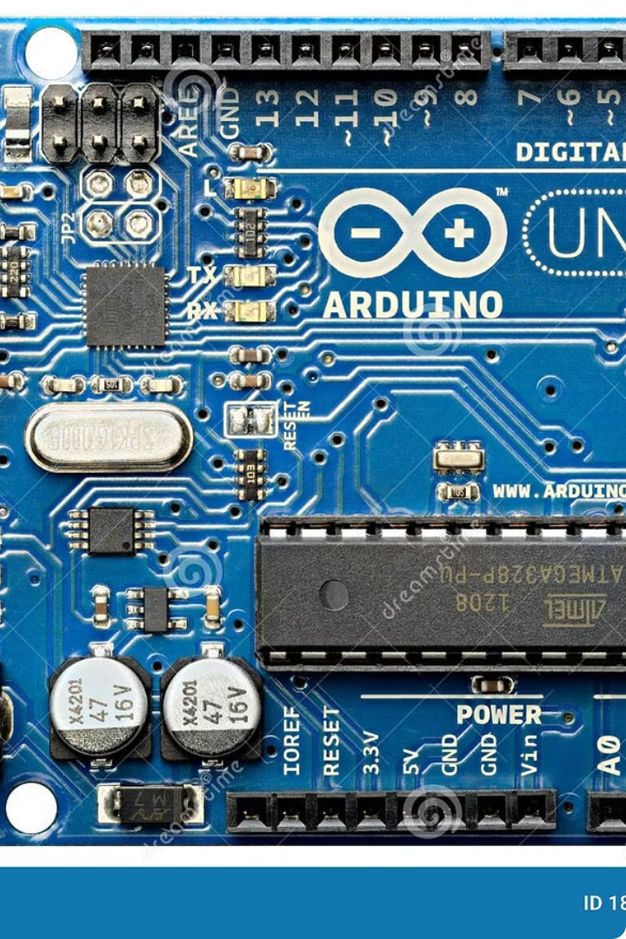
Arduino Uno Microcontroller
The Arduino Uno is a powerful and versatile microcontroller board that forms the heart of the automatic parking gate system. It provides the processing power to coordinate all the system's components and execute the control logic.
With its 32-bit RISC-based Atmel ATmega328P microprocessor, the Arduino Uno offers ample computing resources to process sensor data, control the servo motor, and communicate with other devices seamlessly.

Slide 4
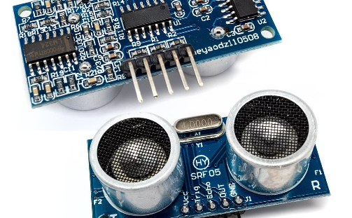
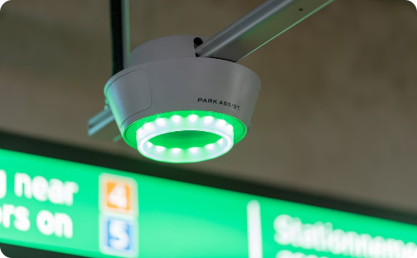
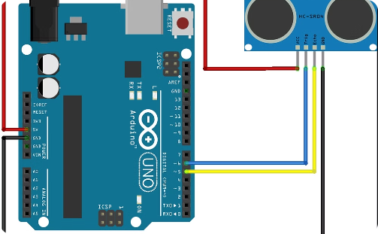
Ultrasonic Sensor for Vehicle Detection
Precise Distance Measurement
Non-Contact Vehicle Monitoring
Integration with Arduino Uno
The ultrasonic sensor uses high-frequency sound waves to accurately detect the presence and distance of vehicles approaching the parking gate, enabling efficient and automated control of the gate's operation.
By using non-contact ultrasonic technology, the sensor can monitor vehicle movement without physically interfering with the flow of traffic, ensuring a seamless and unobstructed parking experience.
The ultrasonic sensor is easily integrated with the Arduino Uno microcontroller, allowing for real-time data processing and intelligent decision-making to control the parking gate's operation.

Slide 5
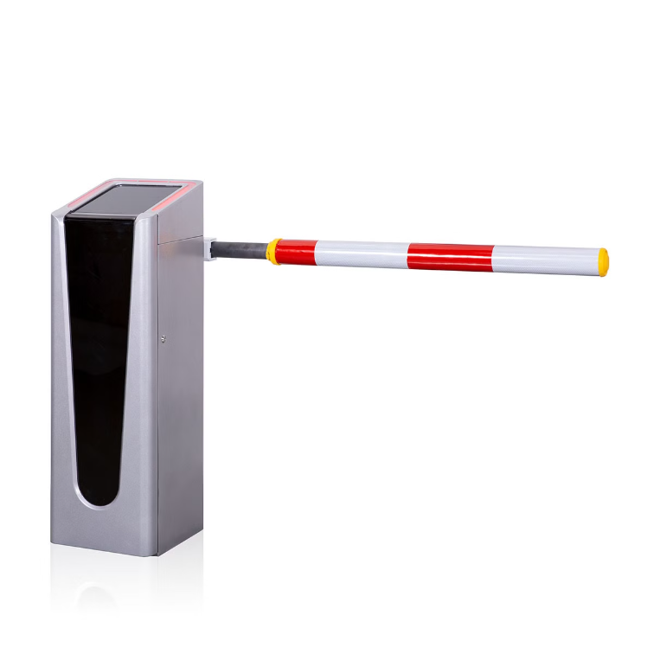
Servo Motor for Gate Operation
The servo motor is a critical component in the automatic parking gate system, responsible for the opening and closing of the gate. It is a precise, rotary actuator that can accurately control the angular position of the gate.
The servo motor receives instructions from the Arduino Uno microcontroller, which determines the appropriate gate position based on the vehicle detection data from the ultrasonic sensor. This allows for seamless, automated control of the gate's movement.

Slide 6
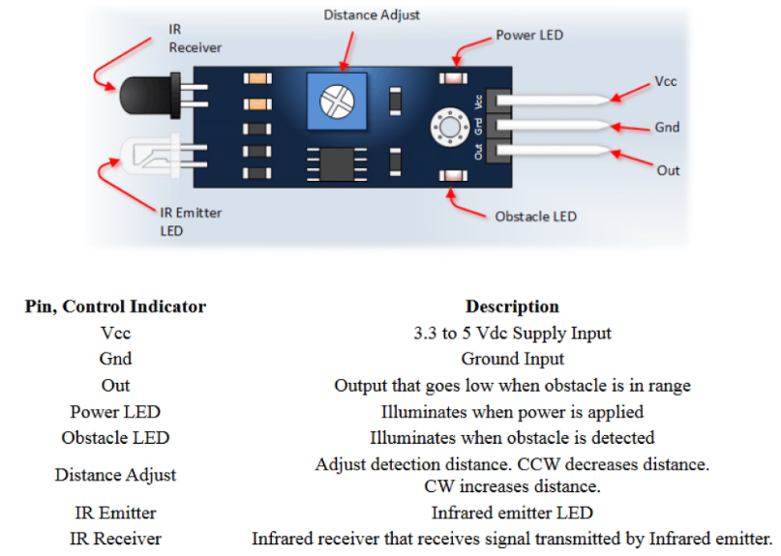
Infrared Sensor for Obstacle Detection
The automatic parking gate system incorporates an infrared sensor to detect obstacles in the gate's path. This sensor emits and receives infrared light, allowing it to sense the presence of vehicles, pedestrians, or other objects that may obstruct the gate's movement.
When the infrared sensor detects an obstacle, it sends a signal to the Arduino Uno microcontroller, which then pauses or reverses the gate's motion to prevent collision and ensure safe operation.

Slide 7



Software Implementation and Programming
Sensor Interfacing
1
Connect the ultrasonic sensor and IR sensor to the Arduino Uno
Servo Control
2
Program the servo motor to open and close the gate
Logic Programming
3
Implement the detection and gate control logic
The software implementation involves integrating the different components of the automatic parking gate system. First, the ultrasonic sensor and infrared sensor are connected to the Arduino Uno microcontroller. Then, the servo motor is programmed to open and close the gate based on the input from the sensors. Finally, the core logic that controls the gate operation is developed, with the Arduino executing the detection and gate control algorithms.

Slide 8
Benefits and Applications of the System
Improved Efficiency
Enhanced Security
Reduced Labor Costs
Versatile Applications
The automatic parking gate system streamlines the entry and exit process, reducing wait times and traffic congestion in parking facilities.
The system's sensor-based detection and automatic gate operation enhance security by controlling access and preventing unauthorized entry.
By automating the gate operation, the system eliminates the need for manual staffing, leading to significant cost savings for parking lot owners.
This system can be deployed in a variety of settings, including commercial parking lots, residential communities, and even industrial complexes.

Slide 9
Future Scope
Expanded Automation
Integrated Parking Systems
Explore integrating AI-powered computer vision and deep learning algorithms to enhance vehicle detection and gate control.
Combine the gate automation with a comprehensive parking management solution, including space availability tracking and reservation systems.
Renewable Energy Integration
Mobile App Integration
Incorporate solar panels or wind turbines to power the gate system, making it more environmentally friendly and self-sustaining.
Develop a mobile app that allows users to remotely control the gate, receive notifications, and manage their parking access.

Slide 10



Advantages and Disadvantages
Advantages
Disadvantages
Tradeoffs
Automated parking gates enhance security, reduce manual labor, and improve traffic flow. They offer convenience, efficiency, and cost savings for parking facility operators.
Initial installation and maintenance costs can be high. Power outages or system malfunctions may cause disruptions. Proper user education is required to ensure seamless operation.
While the benefits typically outweigh the drawbacks, a careful assessment of the facility's needs and resources is crucial to determine if an automated parking gate system is the right solution.

